Slide 1
UNSUPERVISED LEARNING
UNSUPERVISED LEARNING
Sourav Karmakar
souravkarmakar29@gmail.com
Sourav Karmakar
souravkarmakar29@gmail.com

Slide 2
UNSUPERVISED LEARNING
The Data has no target attribute or class labels.
We want to explore the data to find some intrinsic structures in them.
Usually the objects / data are grouped into two or more groups based on the similarity or dissimilarity on a particular feature.
Can produce completely different results based on the feature being used for grouping.
Grouping of objects into two or more groups based on the similarity / dissimilarities of objects such that each object fall into exactly one group is called Clustering.

Slide 3
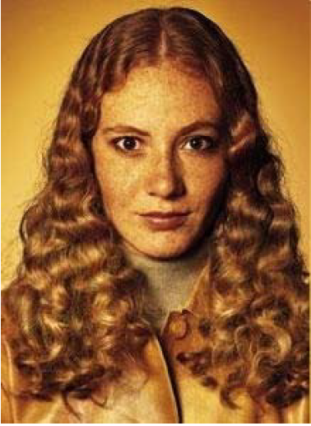
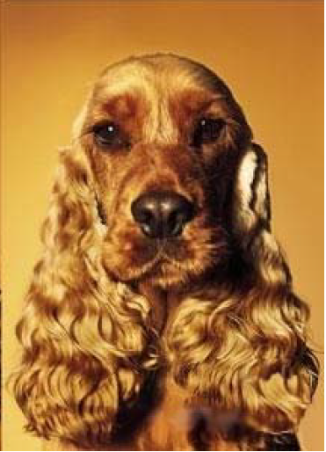
SIMILARITY & DISSIMILARITY
How similar / dissimilar are following two objects?
Definition (Webster’s Dictionary):
The quality or state of being similar; likeness; resemblance; as, a similarity of
features.
Similarity is hard to define but
“We know when we see it”
The real meaning of similarity is a philosophical question. We will take a more pragmatic approach.

Slide 4
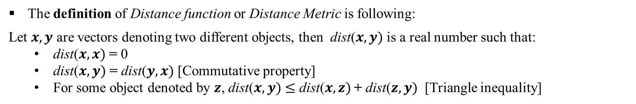
SIMILARITY & DISSIMILARITY
Similarity:
Numerical measure of how similar two data /objects are.
Is higher when objects are more alike.
Dissimilarity:
Numerical measure of how different two data /objects are.
Is lower when objects are more alike.
So between two data objects if similarity increases then dissimilarity decreases and vice versa.
Usually dissimilarity between two objects / data points can be defined in terms of the distance between those two objects / data points. For distant two objects are more is the dissimilarity and less is the similarity.
There are different distance measures for both quantitative and categorical variables.

Slide 5
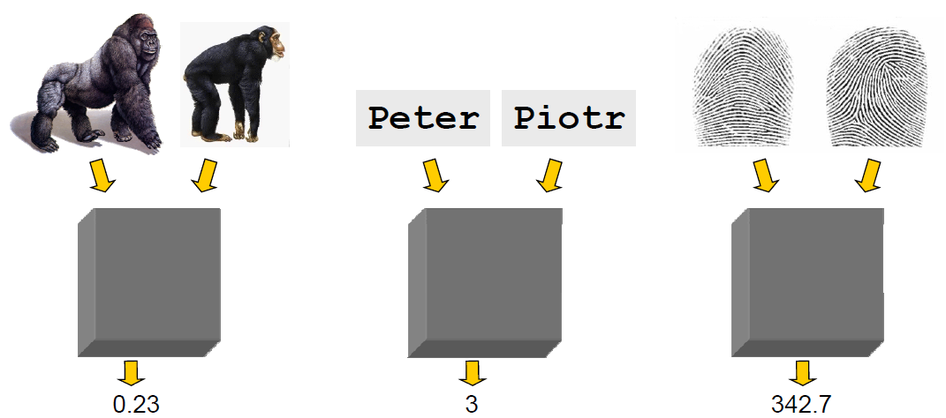
UNSUPERVISED LEARNING

Slide 6
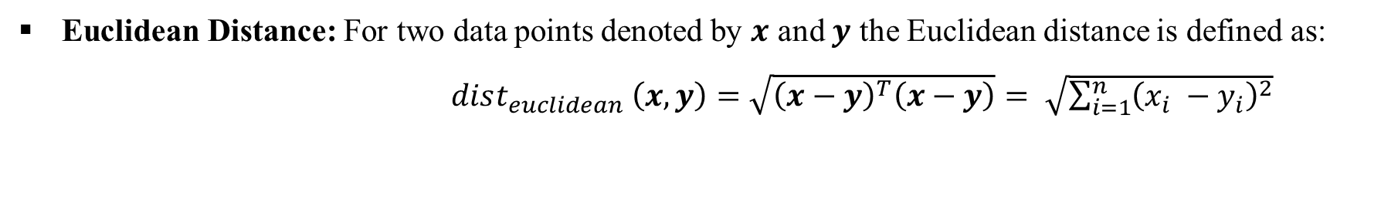
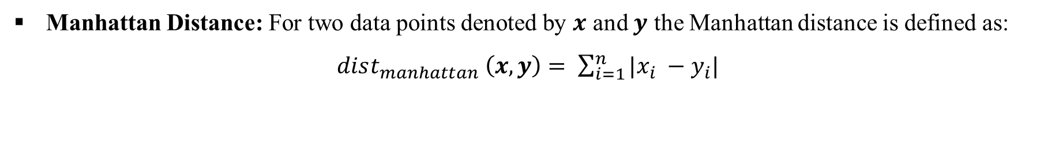
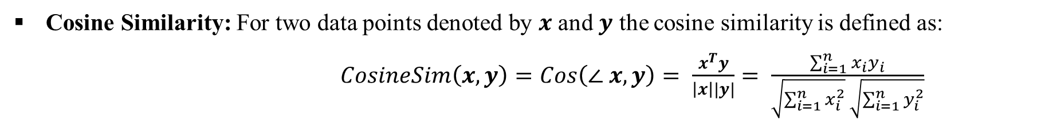



DISTANCE METRICS & SIMILARITY

Slide 7







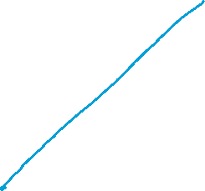

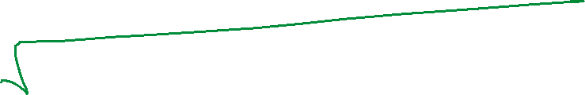






Slide 8













Slide 9




















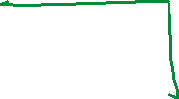



























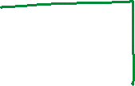














Slide 10








Slide 11
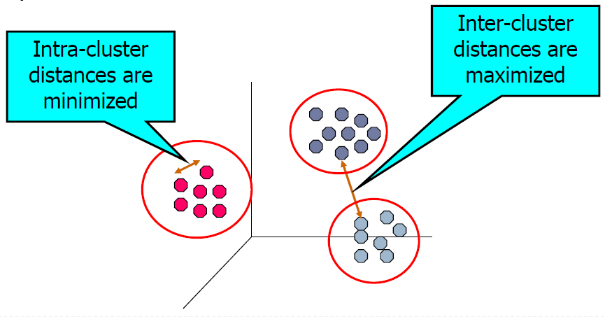
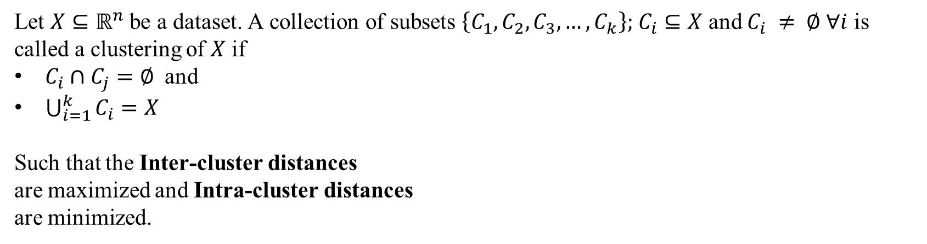
CLUSTERING ANALYSIS
What is Cluster Analysis?
Finding groups of objects in data such that the objects in a group are similar (or related) to one another and different from (or unrelated to) the objects in other groups
Formal Definition
Let $X⊆ℝ^{n}$be a dataset. A collection of subsets $\left\{C_{1}, C_{2}, C_{3}, …, C_{k}\right\};$ $C_{i}⊆X$ and $C_{i} ≠ ∅ ∀i$ is called a clustering of $X$ if
$C_{i}∩C_{j}=∅$ and
$\bigcup_{i=1}^{k}{C_{i}}=X$
Such that the Inter-cluster distances
are maximized and Intra-cluster distances
are minimized.

Slide 12









Slide 13
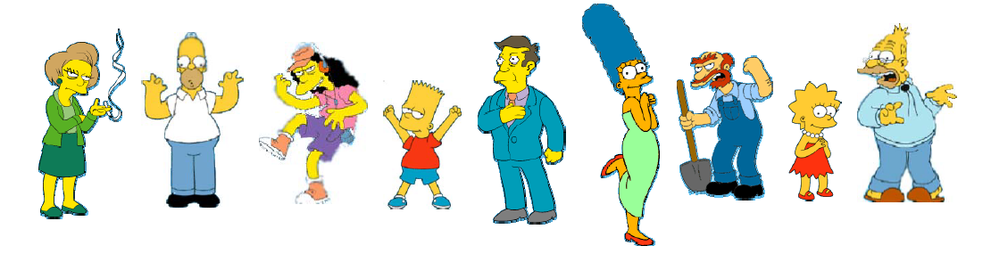
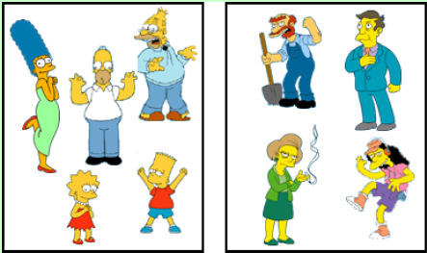
CLUSTERING – AN EXAMPLE
What is the natural grouping among the following objects
Simpson’s Family
School Stuffs

Slide 14
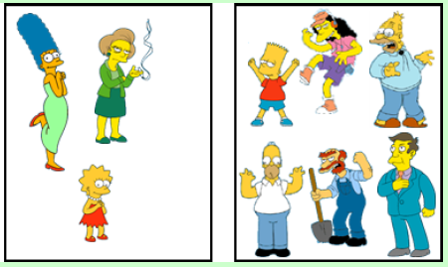
CLUSTERING – AN EXAMPLE
What is the natural grouping among the following objects
Females
Males

Slide 15
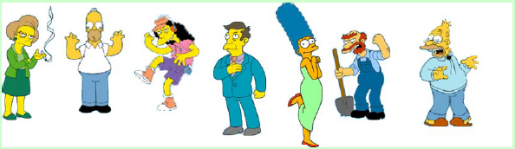
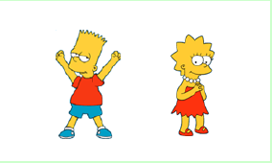
CLUSTERING – AN EXAMPLE
What is the natural grouping among the following objects
Adults
Children
Hence Clustering is Subjective to the choice of feature(s)

Slide 16
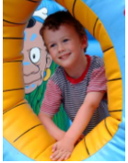
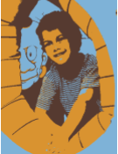
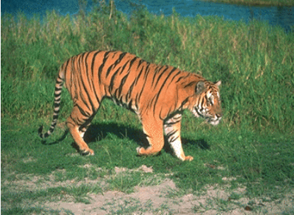
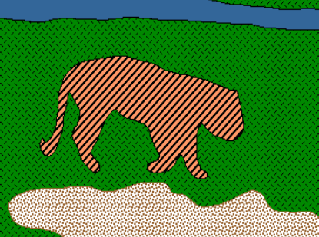
APPLICATIONS OF CLUSTERING
Image Segmentation: Break up the image into meaningful or perceptually similar regions.
Original
Segmented Image
Original
Segmented
Social Network Analysis: In the study of social networks, clustering may be used to recognize communities within large groups of people.
Medical Imaging: On PET (Positron Emission Tomography) scans, cluster analysis can be used to differentiate between different types of tissue and blood in a three-dimensional image.
And Many More…

Slide 17
DIFFERENT TYPES OF CLUSTERING
There are several kinds of Clustering algorithms
Partitional Clustering:
K-Means
K-Medoids
Hierarchical Clustering:
Agglomerative
Divisive
Density Based Clustering:
DBSCAN
OPTICS
Fuzzy Clustering:
Fuzzy C-Means

Slide 18
Thank You

